Slide 1
Crow calls
Josh Stokley
February 20 2018 5:55pm

Slide 2
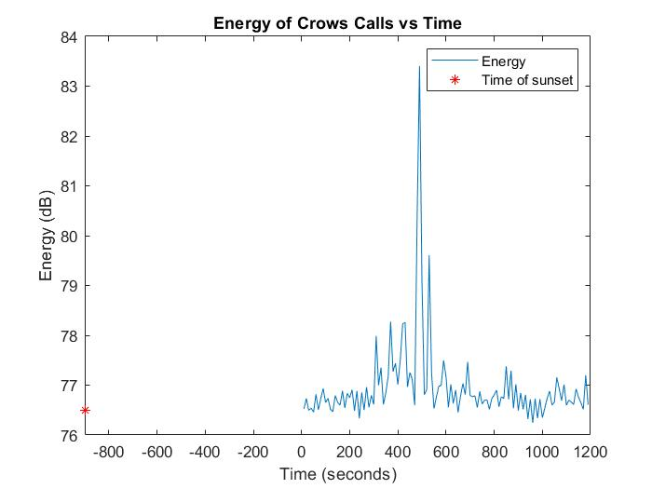
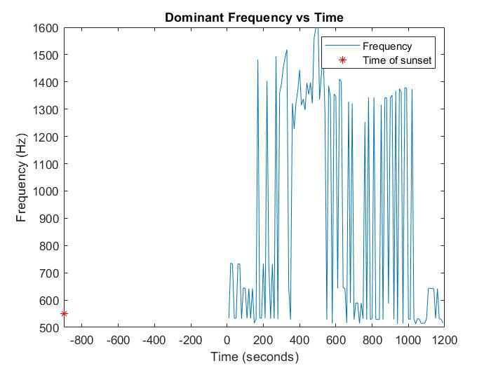
Energy vs Time Dominant Frequency vs Time
Time of sunset = 540pm

Slide 3
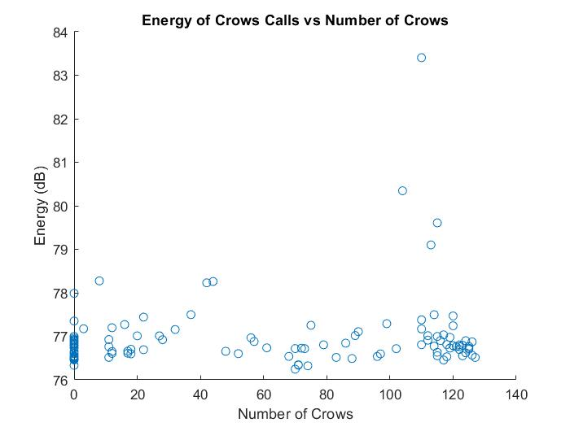
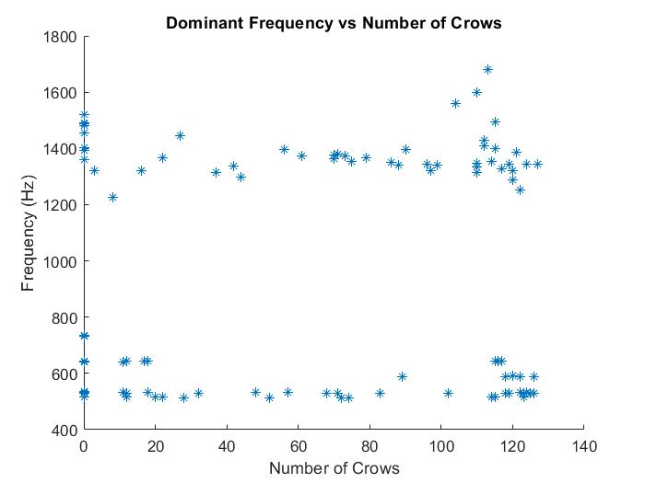
Energy vs Number of Crows Dominant Frequency vs Number of Crows

Slide 4
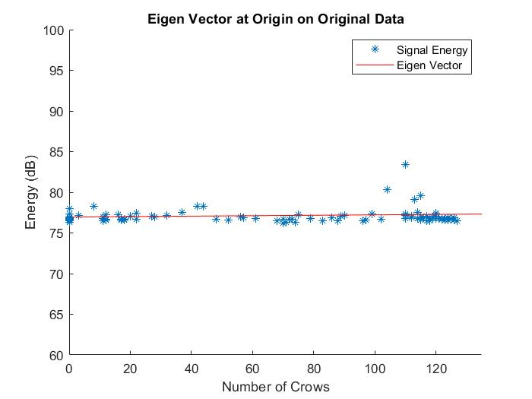
Eigen Value and Eigen Vector
λ(1) = 0.0007
λ(2) = 2.5717
T = 2.5724
λ(2)/T = 99.97%
U2 = -1i - 0.0027j
As the eigen vector increases, it stays almost parallel to the x axis with little increase in the j direction
Results in no correlation between the signal energy and number of crows

